Slide 1
GitHub Training

Slide 2
Introduction
About GIT
Github relies on DVCS (Distributed Version Control System)
Git does not rely on the central server
Helps to perform many operations when you are offline.
Helps to commit changes, create branches, view logs, and perform other operations when you are offline.
Require network connection only to publish the changes and take the latest changes.
Advantages of Git
Free and open source
Fast and Small
Implicit Backup
Security
Easier branching
No need of powerful hardware

Slide 3
Installing Git
sudo apt-get install git-core
https://www.youtube.com/watch?v=J_Clau1bYco
https://git-scm.com
Debian base GNU/Linux distribution
sudo apt-get install git-core
RPM based GNU/Linux distribution
yum -y install git-core
git --version

Slide 4
Configuring Git
Git provides the git config tool
Git stores all global configurations in .gitconfig file located in home directory
Git stores configuration for every user and repository on the system in the /etc/gitconfig file
Setting username - Cmd - git config --global user.name "Usha Maheswari"
Setting email id – Cmd - git config --global user.email "usha-maheswari-paul.durai@capgemini.com"
Avoid merge commits for pulling – Cmd - git config --global branch.autosetuprebase always
Color highlighting – Cmd - git config --global color.ui true
git config --global color.status auto
git config --global color.branch auto
Setting default editor – Cmd - git config --global core.editor vim
Setting default merge tool – Cmd - git config --global merge.tool vimdiff
Listing Git settings - Cmd - git config --list

Slide 5
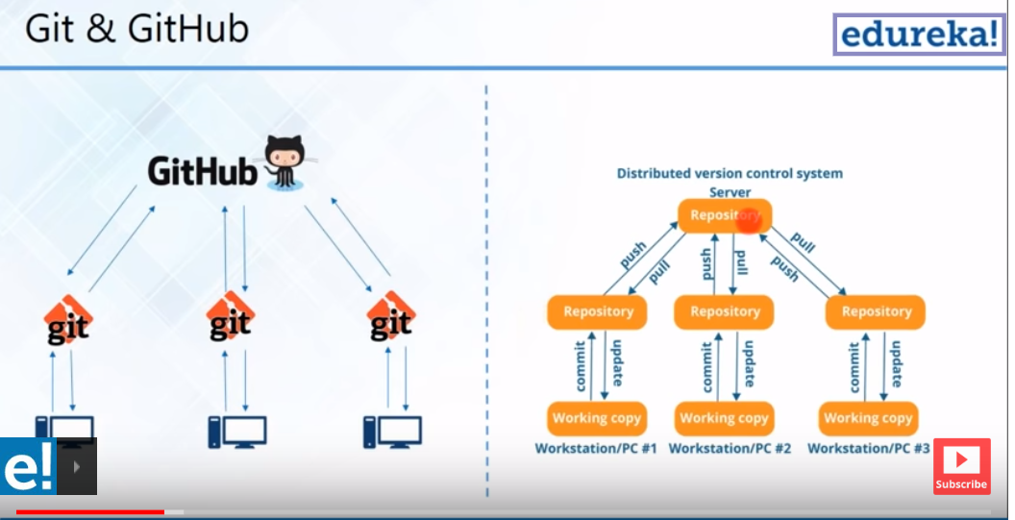
Understanding GitHub flow

Slide 6
Organizations, Teams, and Collaborators
https://www.youtube.com/watch?v=SUu6cmcC-3A
https://www.youtube.com/watch?v=y3AuydEpEgk
https://developers.sap.com/tutorials/webide-github-creating-org.html
https://help.github.com/enterprise/2.15/admin/guides/user-management/creating-teams/
https://gist.github.com/nzakas/5511916
Sign in to GitHub and create an organization
Collaborator: someone on the core development team of the project and has commit access to the main repository of the project.
Invite collaborators to the organization by entering their email id/GitHub username.
Do ensure the collaborator has a GitHub account else the person will not be added as a collaborator. Click on Finish once done.
Click on the appropriate role for the collaborator being added and then click on Send Invitation.
The collaborator will receive an email, follow the link on the email to accept invite.
Teams : is a powerful way to control repository access.
Under organizations you can create teams.

Slide 7
Issues, wikis, pages
https://www.gitkraken.com/glo
Issues are a great way to keep track of tasks, enhancements, and bugs for your projects
Most software projects have a bug tracker of some kind.
GitHub's tracker is called Issues, and has its own section in every repository.
A separate system for documentation called Wiki, is built right into each GitLab project.
It is enabled by default on all new projects and you can find it under Wiki in your project
You can create/edit/delete/move or view wiki pages
In order to link the issue number to your commit message, you should add: #issue_number in your git commit message.

Slide 8
Working remotely with Git

Slide 9
How to create a new Repository
Create a new repository on your personal account or any organization where you have sufficient permissions.
You can choose to make the repository either public or private.
If your instance is not in private mode or behind a firewall, public repositories are visible to the public, while private repositories are only accessible to you and people you share them with.
You can create a README, which is a document describing your project. For more information, see "About READMEs."
You can create a .gitignore file, which is a set of ignore rules. For more information, see "Ignoring files

Slide 10
Working remotely with Git- Create Remote Repository
https://www.youtube.com/watch?v=LPT7v69guVY – Adding eclipse project to Git
Create a remote Git repository after creating new user
[gituser@CentOS ~]$ mkdir project.git
[gituser@CentOS ~]$ cd project.git/
[gituser@CentOS project.git]$ ls
[gituser@CentOS project.git]$ git --bare init
Initialized empty Git repository in /home/gituser-m/project.git/
[gituser@CentOS project.git]$ ls
branches config description HEAD hooks info objects refs

Slide 11
Git - Clone Operation
Clone operation creates an instance of the remote repository.
Jerry creates a new directory in his home directory and performs the clone operation.
[jerry@CentOS ~]$ mkdir jerry_repo
[jerry@CentOS ~]$ cd jerry_repo/
[jerry@CentOS jerry_repo]$ git clone gituser@git.server.com:project.git
Git add operation adds file to the staging area.
[jerry@CentOS project]$ git status -s
?? string
?? string.c
[jerry@CentOS project]$ git add string.c
Git commit commits the files
[jerry@CentOS project]$ git commit -m 'Implemented my_strlen function‘
Git shows the difference between committed file and changed file
[jerry@CentOS project]$ git diff

Slide 12
How to push changes to remote repository
[tom@CentOS ~]$ pwd
/home/tom
[tom@CentOS ~]$ mkdir tom_repo
[tom@CentOS ~]$ cd tom_repo/
[tom@CentOS tom_repo]$ git init
Initialized empty Git repository in /home/tom/tom_repo/.git/
[tom@CentOS tom_repo]$ echo 'TODO: Add contents for README' > README
[tom@CentOS tom_repo]$ git status -s
?? README
[tom@CentOS tom_repo]$ git add .
[tom@CentOS tom_repo]$ git status -s
A README
[tom@CentOS tom_repo]$ git commit -m 'Initial commit‘ -- command to commit new file in a new directory
[tom@CentOS tom_repo]$ git log

Slide 13
Continued …
After committing changes to the local repository push the changes to the remote repository.
We have to add the repository as a remote, this is a one-time operation. After this, we can safely push the changes to the remote repository.
[tom@CentOS tom_repo]$ git remote add origin gituser@git.server.com:project.git
[tom@CentOS tom_repo]$ git push origin master

Slide 14
How to pull changes from remote repository
Fetch command to get latest change
[jerry@CentOS project]$ git fetch
Pull Latest Changes from remote repository
Jerry executes the git pull command to synchronize his local repository with the remote one.
[jerry@CentOS project]$ git pull
Git - Stash Operation
Takes your modified tracked files, stages changes, and saves them on a stack of unfinished changes that you can reapply at any time.
jerry@CentOS project]$ git stash
Execute the git stash popcommand, to remove the changes from the stack and place them in the current working directory.
[jerry@CentOS project]$ git stash pop

Slide 15
Creating Branches and Tags
https://www.youtube.com/watch?v=tICdLNBJVFA - branch
https://www.youtube.com/watch?v=JTE2Fn_sCZs – branch
https://www.youtube.com/watch?v=WKG1u4Y_f3s – tags
What is a Tag - a version of a particular branch at a moment in time.
What is a Branch - a separate thread of development that may run concurrently with other development efforts on the same code base.

Slide 16
Merging/Renaming/Deleting Branches
https://www.youtube.com/watch?v=0iuqXh0oojo
Merge command
The "merge" command is used to integrate changes from another branch
git checkout a (you will switch to branch a)
git merge b (this will merge all changes from branch b into branch a)
git commit -a (this will commit your changes)
Rename Command
If you are on the branch you want to rename:
git branch -m new-name
If you are on a different branch:
git branch -m old-name new-name
Delete the old-name remote branch and push the new-name local branch.
git push origin :old-name new-name

Slide 17
Delete a Git Branch
Deleting local branches in Git
$ git branch -d feature/login
To delete a remote branch, we do not use the "git branch" command -
but instead "git push" with the "--delete" flag:
$ git push origin --delete feature/login

Slide 18
Recovering deleted commits
Find your commit in reflog use:
git reflog
to display all commits which are/were created in your repository –
after this you should checkout to removed commit by checkout command
git checkout <your commit-SHA>
git push origin master

Slide 19
Cherry picking changes
Cherry picking in git means to choose a commit from one branch and apply it onto another.
Scenario – you have committed to wrong branch by mistake. You can revert the cherry-pick the commit and apply it to the correct branch.
[jerry@CentOS project]git cherry-pick <commit id>
Here commit id is activity id of another branch.Eg.
[jerry@CentOS project]git cherry-pick 9772dd546a3609b06f84b680340fb84c5463264f

Slide 20
Rebasing concepts and usage
Rebase command integrates changes from one branch into another. It is an alternative to the better known "merge" command.
Rebase differs from merge by rewriting the commit history in order to produce a straight, linear succession of commits.
https://www.youtube.com/watch?v=a_msiOrYLgM
[jerry@CentOS project]git add <filename>
After resolving the conflict manually and updating the index with the desired resolution, you can continue the rebasing process with
[jerry@CentOS project]git rebase --continue

Slide 21
Stashing
Git - Stash Operation
Takes your modified tracked files, stages changes, and saves them on a stack of unfinished changes that you can reapply at any time.
jerry@CentOS project]$ git stash
Execute the git stash popcommand, to remove the changes from the stack and place them in the current working directory.
[jerry@CentOS project]$ git stash pop

Slide 22
Working Locally with Git

Slide 23
Creating local repository
https://git-scm.com/docs/git-diff
Adding Files
git add index.html css/styles.css
Committing Changes
git commit -m "Change titles and styling on homepage"
Viewing History and Diff
git log command
git diff test
git diff HEAD -- ./test
git diff HEAD^ HEAD

Slide 24
Staging multiple commits /reverting commit
Staging changes as multiple commits
https://githowto.com/staging_changes
To learn to stage changes for the upcoming commits
git add hello.html
git status
Reverting a commit
The git revert command is a forward-moving undo operation that offers a safe method of undoing changes.
Just undo the last commit:
git reset --soft HEAD~
Or undo the time before last time commit:
git reset --soft HEAD~2
Or undo any previous commit:
git reset --soft <commitID>

Slide 25
Additional concepts
Undoing changes to the working copy
Undoing/redoing changes in the repository
Cleaning the working copy
Ignoring files with gitignore
Specifies intentionally untracked files to ignore
Workflow Concepts
Including External Repositories
Overview of Gitlab - GitLab is a web-based Git-repository manager providing wiki, issue-tracking and CI/CD pipeline features, using an open-source license, developed by GitLab Inc.

Slide 26
Collaborative workflow
In practice, it is good to be sure that you have an updated version of the repository you are collaborating on, so you should git pull before making our changes. The basic collaborative workflow would be:
update your local repo with git pull origin master,
make your changes and stage them with git add,
commit your changes with git commit -m, and
upload the changes to GitHub with git push origin master
It is better to make many commits with smaller changes rather than of one commit with massive changes: small commits are easier to read and review.

